Slide 1

Trending YouTube Videos - UK
Insights on Trending YouTube Videos
Presented By: X
October 27, 2025

Slide 2
Agenda
Dataset Overview
Data Cleaning and Preparation
Feature Engineering and Metric Creation
Exploratory Data Analysis
05
Average Engagement By Category
Music Deep Dive - Popularity vs Engagement
Conculsion
References
01
02
06
03
07
04
08

Slide 3
Back to Agenda Page
Dataset Overview
Dataset Overview and Characteristics
  Source: (Kaggle,2025) - Youtube Trending Videos Dataset (License : CC0: Public Domain)
  Filtered for the United Kingdom (GB) region.
  Features: 16 video metadata features(views, likes, comments, publish date and trending date) and 12 channel metadata features (channel subs, country)
  Timeframe: 3rdth October 2025 - 25th October 2025

Slide 4
Back to Agenda Page
Data Cleaning and Preparation
Overview of how the data was cleaned and prepared for the analysis
  Filtered the dataset for the UK trending videos
  Dropped rows missing critical engagement metrics (likes, comments, views).Kept non-critical missing values (e.g., channel_country) to retain data diversity.
  Converted publish/trending dates → datetime using Pandas to_datetime().
  Removed rows where the number of likes > number of views.

Slide 5
Back to Agenda Page
Feature Engineering and Metric Creation
Feature Engineering for metric level analysis
  days_to_trend — difference between trending date and published date. Measures how many days it took to reach trending after publishing.
  engagement rate — (like count + comment count) / view count. Represents interaction per view
  days_trending — count of unique video_trending__date per video_id. Indicates how long a video stayed on the trending list.

Slide 6
Back to Agenda Page
Exploratory Data Analysis
Initial exploration of the dataset
  Average engagement rate for trending videos ≈ 4%, max 93% (after removing outliers).
  Strong positive correlation between likes and views (r = 0.83).
  Comments and likes also correlate strongly (r = 0.77), indicating that interactive audiences both like and comment.
  Comments and views (r = 0.55) show a moderate relationship — not all highly viewed videos generate discussion.

Slide 7
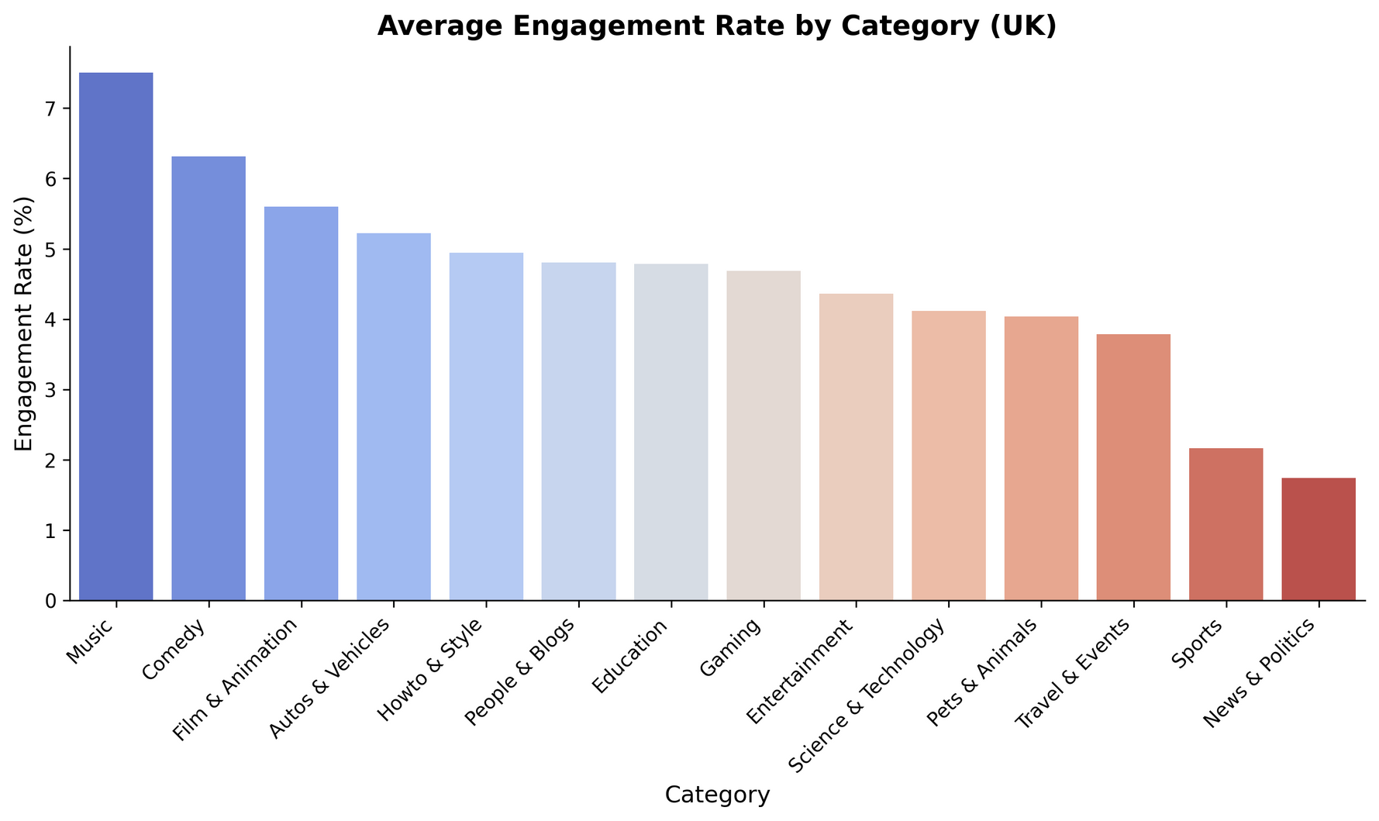
Average Engagement by Category
Back to Agenda Page
  The Music category shows the highest engagement rate (~7%), indicating strong audience interaction.
  Sports, News & Politics content show lower engagement (1–2%).
  This aligns with Ofcom’s 2025 report, which found that 93% of UK adults listen to music weekly, and YouTube holds a 47% share of all online music listening.

Slide 8
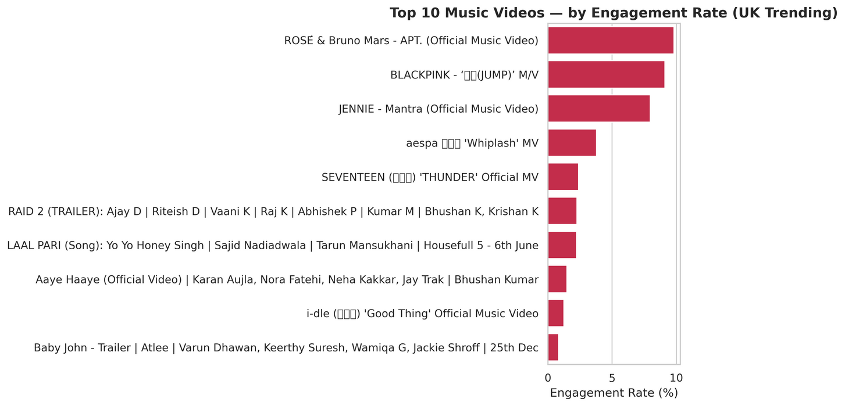
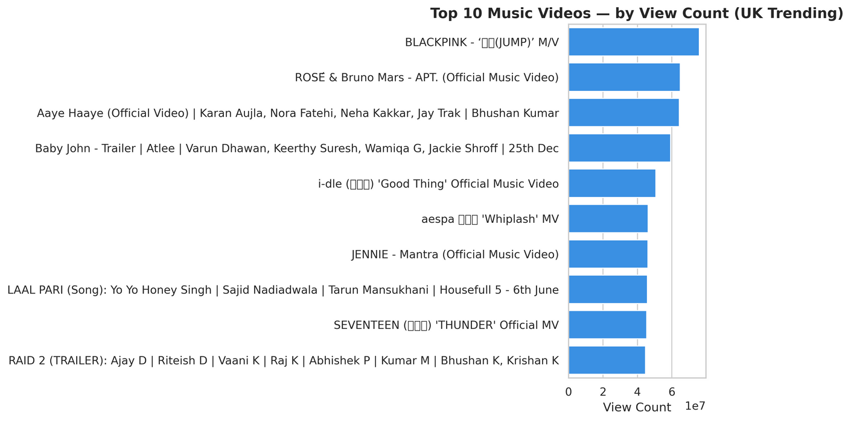
Music Deep Dive — Popularity vs Engagement
Back to Agenda Page
  BLACKPINK dominates both visibility and engagement in UK trending lists.
  ROSÉ & Bruno Mars collaboration holds the highest engagement (~10%) among music videos.
  Indian music and film trailers (T-Series, JioStudios) show broad reach but low engagement (<2%).
  Indicates strong fan-driven loyalty in K-pop audiences versus passive viewing for film content.
  The high engagement aligns with a growing youth-driven K-pop culture in London, where young audiences connect with music as a form of identity and community (The Korea Times, 2025).

Slide 9
Conclusion
Back to Agenda Page
  The YouTube Trending dataset (UK subset) shows that Music content drives the highest engagement (~7%), while categories like Sports and News remain lower (1–2%).
  Music videos reach trending lists faster and generate stronger viewer interaction, especially for artists like BLACKPINK, ROSÉ, and JENNIE.
  Engagement correlates strongly with views and likes, confirming that visibility drives audience interaction.
  Insights align with external research (Ofcom, 2024; The Korea Times, 2025) — showing that music consumption is done on regular basis in UK by younger people and trend of the younger audiences towards K-pop
  This highlights YouTube’s ongoing role as a primary platform for music discovery and fan engagement in the UK.

Slide 10
References
Back to Agenda Page
  (Ofcom, 2025) https://www.ofcom.org.uk/media-use-and-attitudes/media-habits-adults/tuning-into-youtube-uks-media-habits-revealed
  (Korea Times, 2025) https://www.koreatimes.co.kr/entertainment/k-pop/20250626/why-k-pops-rise-in-london-is-about-more-than-just-music
  (Kaggle, 2025) https://www.kaggle.com/datasets/canerkonuk/youtube-trending-videos-global

